Slide 1
Real-time Stabilization and 3D Reconstruction of Hand Gestures and Finger Movement Traces Using LED-Equipped Gloves
Software Requirements Specification (SRS)
Team 5 - 11/10/2024
Soham Naik, Alan Raj, Zaynab Mourtada, Alan Raj

Slide 2
Introduction and Objectives
Project Goal: This project aims to develop a mobile application that can provide stable, accurate, real-time gesture tracking.
Target Users: The app is intended for individuals with hand instability, particularly targeting patients with Parkinson's disease who experience tremors.
Benefits: The project will improve accessibility and user interaction in VR/AR and other interactive platforms. This will be achieved by minimizing hand instability in gesture-based systems.
Key Objectives:
Create an intuitive and accessible gesture-based interface that stabilizes and smooths hand movements, particularly for virtual writing.
Develop a reliable gesture recognition system to support users in VR/AR environments and other interfaces that require precise control.
Provide a robust system for real-time gesture processing that minimizes tremor impact and enhances hand gesture accuracy.

Slide 3
System Scope and Functionality
System Overview: The Adaptive HCI software is a mobile application designed to facilitate real-time gesture tracking and smoothing. The application will allow users to interact seamlessly in VR/AR and other gesture-based environments by stabilizing hand movements and minimizing tremors.
Inputs:
LED-Equipped Glove Data: The system will capture and transmit data from LED-equipped gloves in real-time. The data includes LED positions as (x, y, z) coordinates, allowing for precise gesture tracking.
Video Stream from Device Camera: A live video feed from the device's camera will be used to detect LED positions and trace hand gestures in 3D space.
User Commands and Settings: The system will accept user commands to start/stop tracking, adjust gesture smoothing levels, and switch between VR/AR modes.

Slide 4
System Scope and Functionality (ext.)
Processing:
Gesture Tracking and Detection: The system will analyze LED positions from the gloves to recognize hand gestures and map them accurately in real-time.
Real-Time Smoothing and Stabilization: Machine learning algorithms (CNN-LSTM) will be employed to reduce tremors and smooth gesture paths, resulting in stable and continuous traces.
Adaptive Lighting Adjustment: The system will modify tracking parameters based on ambient light conditions to ensure consistent LED detection and accurate tracking across different lighting environments.
3D Visualization for VR/AR: The system will render stabilized hand gestures in 3D space, allowing users to view and interact with their gestures in an immersive environment.
Outputs:
Real-Time Gesture Path Display: The smoothed gesture path will be displayed on the smartphone screen or a connected VR/AR device.
Session Data for Further Analysis: Processed gesture data will be stored for future reference and analysis, potentially enabling personalized model adaptation.
VR/AR Interactive Experience: The system will render an immersive 3D visualization of gesture paths within a virtual environment. This will allow users to interact with virtual objects using their stabilized hand gestures.

Slide 5
System Context and Constraints
System Context: The Adaptive HCI system will be accessible through a mobile app and run primarily on smartphones equipped with rolling shutter cameras. Low-latency processing and multi-user scalability are critical due to the system's real-time tracking requirements. The project is designed to be integrated with different platforms (e.g., VR headsets, IoT devices) in the future.
Major Constraints:
Time Constraints: The project needs to be completed within an academic semester, leading to tight project milestones.
Hardware Limitations: The application needs to support rolling shutter cameras found on various smartphones. However, some image processing techniques might be computationally demanding, requiring optimization for lower-end devices.
Privacy: All data must be processed locally or stored securely to protect user privacy. Additionally, non-relevant background information needs to be filtered out.
Accuracy and Responsiveness: The system must balance smoothing algorithms with gesture responsiveness to maintain user control without introducing excessive delay or unintended gesture modifications.

Slide 6
User Profiles and Scenarios
Local/Guest User (Default):
This is the default mode, offering users access to all application features without requiring an account.
A pre-trained neural network model will provide immediate gesture smoothing.
All data remains on the device, and the model is continuously fine-tuned based on locally captured user data.
The system enhances the personalized smoothing effect by adapting to the user's gestures.
Registered User (Potential Future Enhancement):
Users could optionally create accounts in a future version, enabling personalized neural network settings to be linked to their profiles.
Account Benefits: Personalized model settings and neural network weights would be stored and linked to the account. This would allow for easy transfer of the personalized model to a new device and ensure a consistent user experience across devices.

Slide 7
Data Model and Key Objects
Data Objects: The Adaptive HCI software will manage various data objects.
User Data: Stores session details, preferences, and potentially neural network weights.
Gesture Tracking Data: Contains real-time capture of hand movements and positions, including timestamped 3D coordinates.
Visualization Data: Manages data for rendering smoothed gesture paths in 3D for display on smartphones or VR headsets.
Performance Metrics: Tracks system performance indicators such as frame rate, processing time, and accuracy.
Relationships:
User Data is linked to Gesture Tracking Data, allowing for personalized neural network adjustments based on user activity.
Gesture Tracking Data is connected to Visualization Data, providing real-time display updates.
Performance Metrics are tied to Gesture Tracking Data and Visualization Data to analyze app responsiveness in various conditions.

Slide 8
Functional Model - Mobile Application Use Case
Use Case Name: Mobile Application (MA-01)
Actors:
User: Interacts with the mobile application to initiate and stop gesture tracking.
Preconditions:
The mobile app is installed and running, with necessary permissions granted.
The rolling shutter camera is properly connected.
LED gloves are charged, powered on, and paired.
Triggers:
User opens the app and selects "Start Tracking" or "Stop Tracking."

Slide 9
Functional Model - Mobile Application Use Case (ext.)
Scenario Description:
The user launches the app and initiates tracking.
The app activates the camera and LED gloves to capture data.
The app processes data from the camera and gloves to create a real-time simulation.
Simulated hand movements are displayed on the app interface.
The user can stop tracking, and data is saved.
Post Conditions:
The system captures and processes the user's hand gestures using data from the LED gloves and camera.
Real-time simulation of gestures is successful.
Captured data is available for further analysis or use.
Exceptions:
Server Exceptions: Issues with server communication, internet connectivity, or connection interruptions.
Camera Exceptions: Problems with camera initialization, hardware errors, detection, or compatibility.
Glove Exceptions: Errors with LED glove pairing, hardware malfunctions, detection, or compatibility issues.

Slide 11
Data Dictionary

Slide 12
Data Dictionary - User Data
userID: A unique string identifier assigned to each user upon account creation, ensuring system-wide uniqueness.
sessionStartTime: Timestamp (DateTime) marking the beginning of a user session, used to log interaction duration.
sessionEndTime: Timestamp (DateTime) marking the end of a user session.
neuralNetworkWeights: An array of floating-point values representing personalized neural network weights for individual users, used for gesture customization and consistency across devices.

Slide 13
Data Dictionary - Gesture Tracking Data
gestureID: A unique string identifier for each captured gesture.
timestamp: A DateTime record for each frame in the gesture, stored as a 4D array (x, y, z, time) to maintain continuity of gesture flow.
positionX, positionY, positionZ: Float values representing the 3D coordinates of the LED glove in space, tracking the path of each gesture.
PWM Signature: Pulse Width Modulation rate (Integer) associated with the LED glove, used to uniquely identify and differentiate it from other light sources in the environment.
Environmental Conditions: Describes ambient lighting conditions as a string to adjust gesture tracking parameters accordingly. These conditions help calibrate tracking algorithms for optimal performance.

Slide 14
Data Dictionary - Visualization Data
path3DData: An array of floating-point values representing the smoothed 3D coordinates of the gesture path, processed for VR/AR visualization.
deviceType: A string that specifies the type of device used to ensure compatibility and appropriate display adjustments.
renderingSettings: A string that includes visual quality and responsiveness settings based on device capabilities, adjusting for frame rate, resolution, or latency as required.

Slide 15
Data Dictionary - Performance Metrics
frameRate: A floating-point value representing the rate of video capture during gesture tracking, measured in frames per second (fps).
processingTime: A float representing the time taken to process each frame for gesture recognition, smoothing, and visualization.
accuracy: A float indicating the percentage of correct predictions made by the machine learning model for gesture recognition.

Slide 16
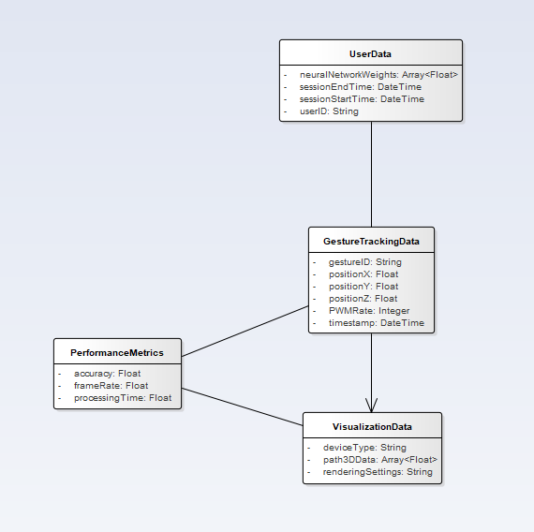
Data Dictionary - Class Diagram

